Slide 1

Potential Energy II
Adopted from MIT Course
FISIKA DASAR 1

Slide 2

Calculating in Potential Energy
Gravitational potential energy (PE) is the energy stored in an object as a result of its height.
It can be calculated using weight (which is mass times gravity) and height.
It is given by the following equation
PE = m g h
The work done to change the object's height is proportional to the change in potential energy.
W = ∆PE = PE_{final} – PE_{initial}
Adopted from MIT Course

Slide 3
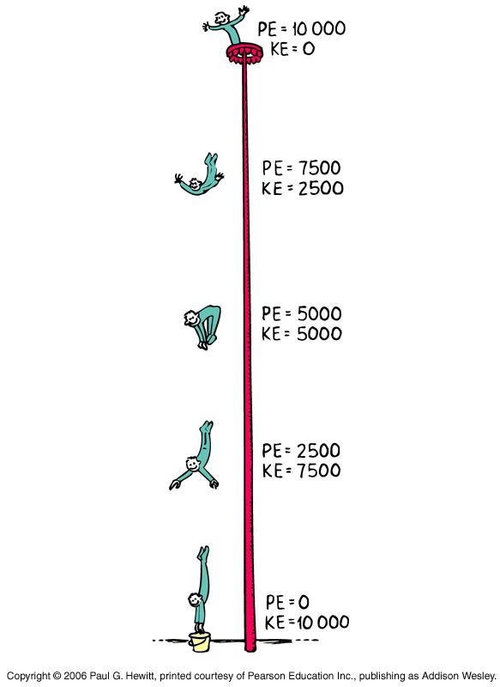
Potential Energy Converted to Kinetic Energy
When stored energy begins to move, the object now transfers from potential energy into kinetic energy.
Potential energy can be converted into kinetic energy and back.
∆KE = - ∆PE
KE_{i} + PE_{i} = KE_{f +} PE_{f}
If there is no work done by non conservative forces, total mechanical energy is constant.
E = KE + PE
Source: physicsclassroom.com/mmedia/energy/ce.cfm
Adopted from MIT Course

Slide 4
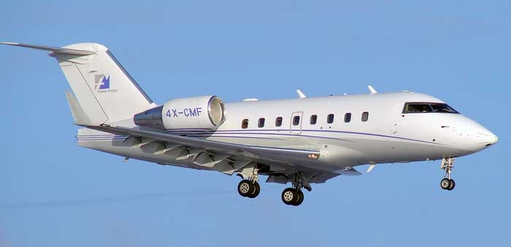
Example 1
e
A 14 300 kg airplane is flying at an altitude of 497 m at a speed of /h. Determine the airplane's total mechanical energy
A 14.000 kg airplane is flying at an altitude of 490 m at a speed of 216 km/h. Determine the airplane's total mechanical energy.
Source: flightzona.com
Solution:
E = KE + PE
= ½mv² + mgh
= ½ (14000) (60)² + (14000) (10) (490)
= 93,8 × 10⁶ J

Slide 5
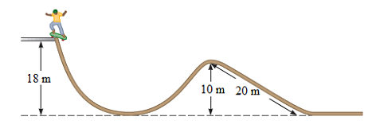
Example 2
e
A 14 300 kg airplane is flying at an altitude of 497 m at a speed of 214 km/h. Determine the airplane's total mechanical energy
Tony (m = 66 kg) rides his skateboard starts from rest at the top of the track and begins a descent down the track. If mass of the skateboard and friction is negligible, what is Tony’s speed when he reaches the bottom of the initial track, 18 m below the starting point?
Solution:
From the law of conservation of energy, potential energy at the top transforms into the kinetic energy at the bottom of the track.
EP = KE
mgh = ½mv²
gh = ½v²
10 × 18 = ½ × v²
v = 18,9 m/s

Slide 6
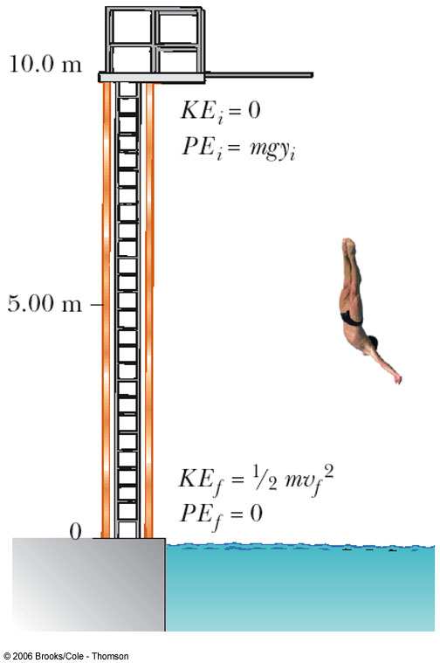
Example 3
e
A diver of mass m drops from a board 10.0 m above the water’s surface. Neglect air resistance.
(a) Find is speed 5.0 m above the water surface
(b) Find his speed as he hits the water

Slide 7
Solution
e
Find his speed 5.0 m above the water surface
KE_{i} + PE_{i} = KE_{f} + PE_{f}
½mv_{i}² + mgh_{i} = ½mv_{f}² + mgh_{f}
0 + mgh_{i} = ½mv_{f}² + mgh_{f}
v_{f}² = 2g(h_{i} – h_{f})
v_{f}² = 2(10)(10 – 5)
v_{f} = 10 m/s
(b) Find his speed as he hits the water
KE_{i} + PE_{i} = KE_{f} + PE_{f}
½mv_{i}² + mgh_{i} = ½mv_{f}² + mgh_{f}
0 + mgh_{i} = ½mv_{f}² + 0
v_{f}² = 2gh_{i}
v_{f}² = 2(10)(10)
v_{f} = 14 m/s

